Slide 1
Full Stack Application Development
Application Development- Introduction
Introduction to the Various Applications
Cloud Native Applications
Akshaya Ganesan

Slide 2
Cloud-Native Applications

Slide 3
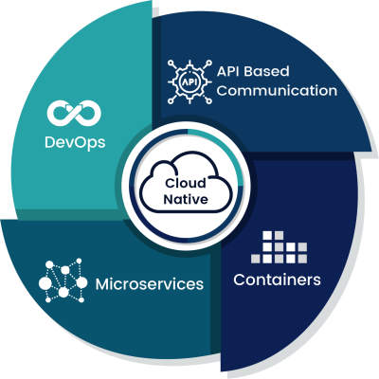
Cloud Native Application
Cloud-native is an approach to developing, deploying, and running applications using modern methods and tools.
The Cloud Native Computing Foundation(CNCF) defines
Cloud-native technologies empower organizations to build and run scalable applications in modern, dynamic environments such as public, private, and hybrid clouds. Containers, service meshes, microservices, immutable infrastructure, and declarative APIs exemplify this approach.

Slide 4
Why Cloud Native
Monolithic Application
A monolithic architecture refers to a traditional software design approach where an entire application is built as a single, self-contained unit.
Key characteristics of monolithic architecture include:
Challenges and Limitations:
Single Codebase
Tight Coupling
Single Deployment Unit
Centralized Database
Development and Scaling Challenges
Longer Development Cycles
Limited Fault Isolation

Slide 5
Cloud-Enabled Solutions
What happens when you move a monolithic app from on-premises to cloud?
A cloud-based application is an existing app shifted to a cloud ecosystem.
They are not able to utilize the full potential of the cloud:
A cloud enabled application is an application that was developed for deployment in a traditional data center but was later changed so that it could also run in a cloud environment.
Not scalable
Less automation
Longer Time to Market

Slide 6
Cloud native vs. traditional applications
Cloud-native applications, however, are built to operate only in the cloud.
With cloud-native applications, you can take advantage of the automation and scalability that the cloud provides.
Developers design cloud-native applications to be:
Scalable
Platform agnostic
Comprised of microservices

Slide 7
Cloud Native Applications
Pillars of Cloud Native
Containers
Microservice
Devops
Continuous Delivery

Slide 8
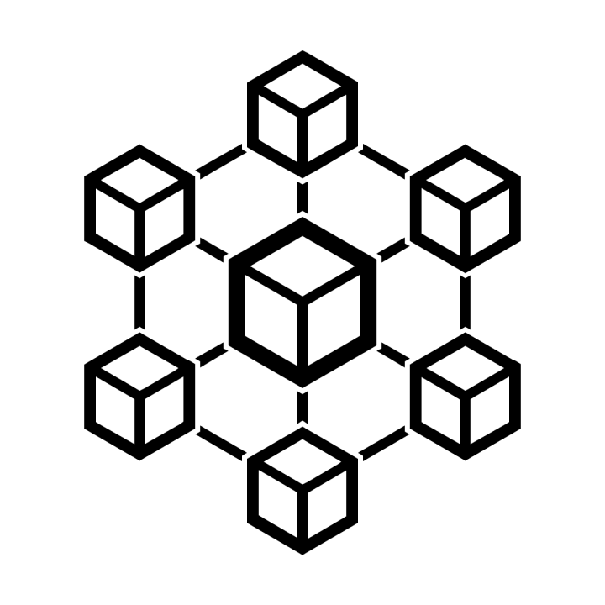
Building Blocks
Microservices
Is an architectural approach to developing an application as a collection of small services.
Each service implements business capabilities, runs in its own process and communicates via HTTP APIs or messaging.

Slide 9
Building Blocks
Containers
Offer both efficiency and speed compared with standard virtual machines (VMs).
Using operating system (OS)-level virtualization, a single OS instance is dynamically divided among one or more isolated containers, each with a unique writable file system and resource quota.
Low overhead of creating and destroying containers combined with the high packing density in a single VM makes containers an ideal compute vehicle for deploying individual microservices.

Slide 10
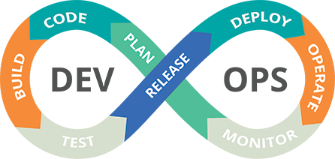
Building Blocks
DevOps
Collaboration between software developers and IT operations to constantly deliver high-quality software that solves customer challenges.
Creates a culture and an environment where building, testing, and releasing software happens rapidly, frequently, and more consistently.

Slide 11
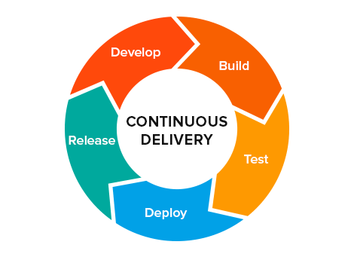
Building Blocks
Continuous Delivery
Is about shipping small batches of software to production constantly through automation.
Makes the act of releasing reliable, so organizations can deliver frequently, at less risk, and get feedback faster from end users.

Slide 12
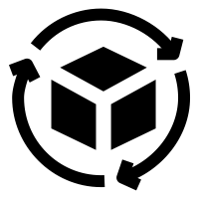
Building Blocks
Continuous Delivery
Is about shipping small batches of software to production constantly through automation.
Makes the act of releasing reliable, so organizations can deliver frequently, at less risk, and get feedback faster from end users.

Slide 13
Advantages
Reduced Time to Market
Ease of Management
Scalability and Flexibility
Reduced Cost

Slide 14
Cloud Native Applications

Slide 15
Thank You!

